Slide 1
Retirement Analyzer
Notes:
Read Slide

Slide 2
Introduction
Are you concerned about potential issues surrounding your retirement?
Whether you are making long range plans, close to retirement, or are already retired, we can help you to create a clearer picture of your financial future.
Notes:
Read Slide

Slide 3
Good News
Today, many people are living longer than ever before. That means that some folks may live 20, 30 or even 40 years in retirement.
Notes:
Read Slide

Slide 4
Bad News
Unfortunately, many folks have no idea what it takes to survive financially throughout retirement. Their main concern is… “will we outlive our money?”
Notes:
Read Slide

Slide 5
Good News
We can help give you a clearer picture of what your retirement years may look like.
Notes:
Read Slide

Slide 6
Bad News
Many people planning for retirement are affected by the “Lump Sum Illusion.” This occurs when a person feels comfortable with a large sum in their retirement portfolio, but haven’t determined how long it will last.
How much money you accumulate at retirement is an important piece of your puzzle, but by itself it doesn’t mean as much as you think.
Notes:
Read Slide

Slide 7
Example
Dan & Sheryl are 53 & 47.
Dan earns $60,000 per year
Sheryl earns $48,000 per year.
Both would like to retire in 10 years.
Total liquid assets = $508,351.
Monthly budget equals $7,000.
This is a hypothetical example. The characters in this example are fictional only. Your actual experience will vary.
Notes:
Read Slide

Slide 8
Outcome
Based on their spending habits and their sources of income such as Retirement Accounts, Social Security and Pensions, and using reasonable projections…….A financial short-fall may be on the horizon.
Without any changes they may run out of money 14 years into retirement!
This is a hypothetical example. The characters in this example are fictional only. Your actual experience will vary.
Notes:
Read Slide

Slide 9
What Does Your Financial Future Look Like?
Notes:
Read Slide

Slide 10
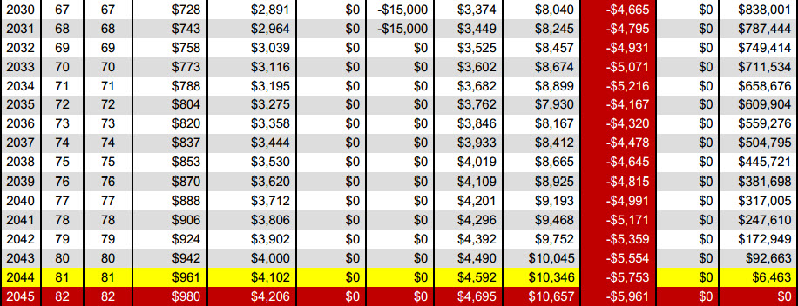
Where is your Red Line?
This is a hypothetical example. The characters in this example are fictional only. Your actual experience will vary. Retirement Analyzer is not a comprehensive financial planning tool.
Notes:
Read Slide

Slide 11
We Can Help You Answer
the Following Questions…
When can I retire without running out of money?
Can I continue my present standard of living into my retirement years?
How can optimizing my Social Security benefit help my specific situation?
How could my situation change during challenging economic times?
How would it affect my family if I die prematurely?
How would it affect my family if I enter a nursing facility?
What are the possible solutions if my situation changes?
Thomas Gold Solutions, LLC does not provide legal or tax advice. Thomas Gold Solutions, LLC can provide information, but not advice related to Social Security benefits. Clients should seek guidance from the Social Security Administration or www.ssa.gov regarding their particular situation.
Notes:
Read Slide

Slide 12
3 Simple Steps
We will gather data to help analyze your current financial picture.
We will make recommendations and provide options subject to your specific situation.
We will be there to help you implement your plan, check progress and answer question or concerns if they arise.
Gather
Recommend
Implement
Notes:
Read Slide

Slide 13
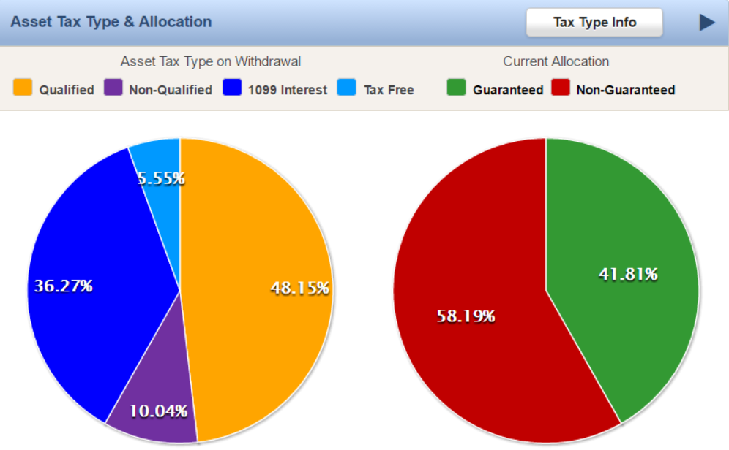
Where are Your Assets?
This is a hypothetical example. The characters in this example are fictional only. Your actual experience will vary.
Notes:
Read Slide

Slide 14
Will You Have Enough?
This is a hypothetical example. The characters in this example are fictional only. Your actual experience will vary. Retirement Analyzer is not a comprehensive financial planning tool.
Notes:
Read Slide

Slide 15
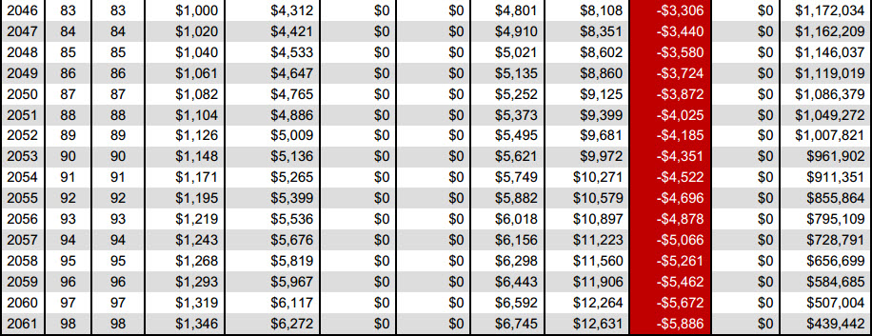
We Can Help You Alleviate Your Red Line
This is a hypothetical example. The characters in this example are fictional only. Your actual experience will vary.
Notes:
Read Slide

Slide 16
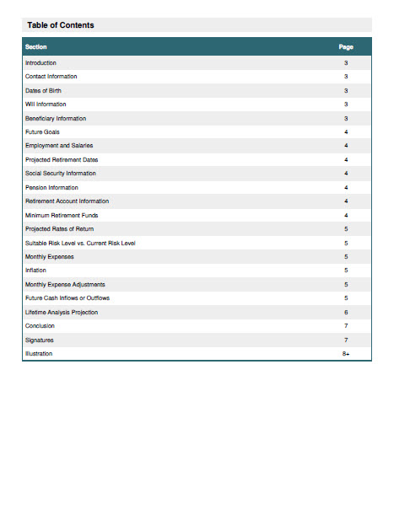
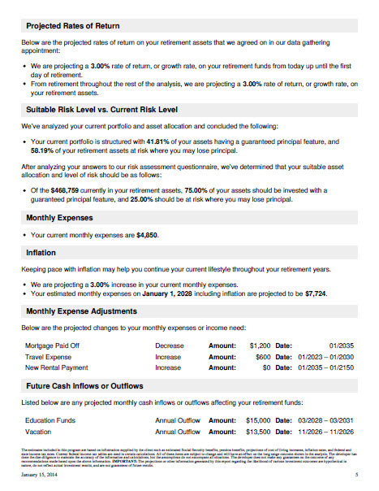
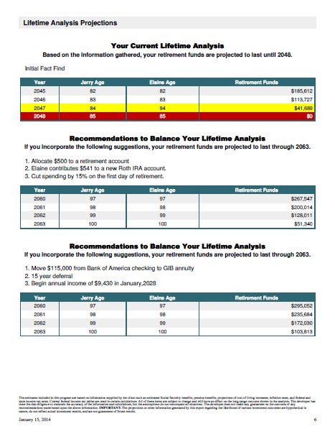
Complimentary Analysis
Easy to understand analysis specific to your situation.
Addresses many of your financial concerns.
Gives you answers to important questions.
Can provide you a sound strategy now and into the future.
Annual Reviews to check and keep the strategy on track.
Notes:
Read Slide

Slide 17
Conclusion
We can help to provide you an idea of what your financial future may look like. The personalized report can show areas of concern and I can make suggestions which may help you attain your goals of a more secure financial future using potential insurance solutions.
It is important to understand that actual results may vary greatly from the projections if estimates are inaccurate or greatly change.
Notes:
Read Slide

